Slide 1
Text structure
Technical reading, W4

Slide 2
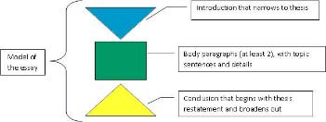
Outline
Academic essay (5 paragraphs)
Introduction, Body paragraphs, Conclusion
Thesis statement, topic sentence
Inside each paragraph
Text structure
Cohesion: support topic sentence
Cohesion: logic flow

Slide 3
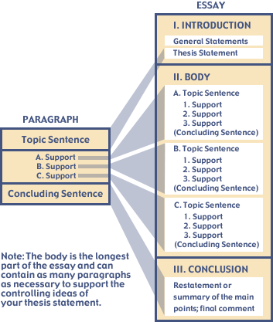
A basic structure for academic essay
Introduction
Motivator
Thesis statement
body paragraphs
Topic sentence
Supporting sentences
…
Conclusion
Restate thesis
Summary of main points

Slide 4
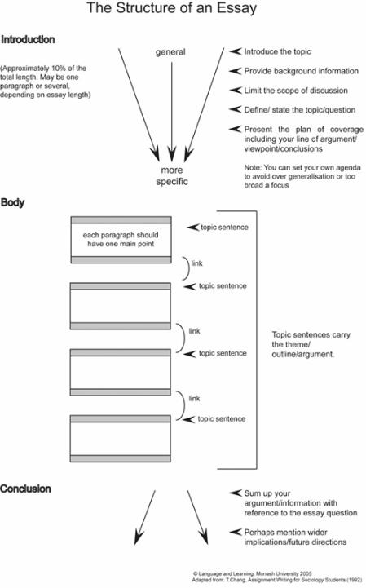
Introduction
Includes a thesis statement, a sentence to sum up all the main ideas
Gives context and background
Tells purpose and organization
Notes:
http://kellimcbride.com/essay_dev_packet.htm

Slide 5
Sample essay
Title: The V's of Big Data: Velocity, Volume, Value, Variety, and Veracity
https://www.xsnet.com/blog/updated-for-2017-the-vs-of-big-data-velocity-volume-value-variety-and-veracity

Slide 6
Thesis statement
In today’s growing digital world, data is king. With over 294 billion emails sent every day and over 1 billion unique Google searches each day, staying on top of how to manage big data can be a key to your organization’s success. This is becoming a growing challenge for organizations in 2017 and will be well into the future. Since the advent of the internet and computer systems, as a whole, the importance and growth of big data has not diminished. And, it likely won’t in the future either. We’ve refreshed this blog to give you insight into the role that big data is playing now and will play into the future. To make sense of big data and what it really means, we have broken it down for you into the five V's: Velocity, Volume, Value, Variety, and Veracity.
Organization

Slide 7
Functions of paragraphs
Paragraphs are building blocks of a technical reports
Three functions:
Provide logical breaks in subject matter
Aid reading by physically breaking a composition into observable units
Logically develop and complete the thought expressed in the topic sentence
Notes:
http://wssa.net/wp-content/uploads/Writing-Effective-Paragraphs.pdf

Slide 8
Notes:
http://www.monash.edu.au/lls/llonline/writing/medicine/psychology/essay-structure/3.xml

Slide 9
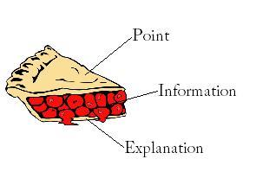
Body paragraphs
In technical articles, the purpose of a paragraph is to support a single claim or idea
One common way to structure a paragraph is PIE
Opens with a main Point that paragraph will discuss (the topic sentence)
The topic sentence supports the thesis statement
Gives Information to support that point
Ends with an Explanation of the information
Notes:
PIE paragraph - http://slideplayer.com/slide/7270455/

Slide 10
PIE paragraph
Point | What is the point of each paragraph? What claim is being made? Often, the point is the topic sentence.
Information | How is the point supported with specific data, experiences, or other factual material? The information is the evidence used to support / develop the point.
Explanation | What does the provided information mean? The explanation is the writer’s analysis, elaboration, evaluation of the point and information given, connecting the information with the point (topic sentence) and the thesis.
Notes:
https://www.slideshare.net/SimonAhern/pie-constructing-paragraphs

Slide 11
Topic sentence
Velocity refers to the speed at which new data is being generated, collected and analyzed, at any given time.
Supporting information
The number of emails, social media posts, video clips, or even new text added per day is in excess of several billion entries. Additionally, this is continuing to increase with lightning speed as tablets and mobile devices are giving us more access to add content online.
Explanation: why it’s important
As new data is added, it is important that it is analyzed in real-time. Big data technology today gives you the ability to instantly analyze data as it is generated.

Slide 12
Exercise
Repeat the analysis of the other 4 body paragraphs in the article “The V's of Big Data: Velocity, Volume, Value, Variety, and Veracity”

Slide 13
Conclusion
Revisits the value of the essay, reviews main points
Restates the thesis
Considers unexplored areas
Connects your argument to the real world
Inspires your reader to reflect or act

Slide 14
Restate thesis statement
As online tools expand and the number of users on the internet grows each day, leveraging big data will be critical in driving valuing for an organization. Analyzing big data can be an efficient tool for growth across many business industries. How to make the most of big data and efficiently analyze it, however, is the new and growing challenge organizations today must consider.
Wider application, future direction

Slide 15
Notes:
http://www.monash.edu.au/lls/llonline/writing/medicine/psychology/essay-structure/3.xml

Slide 16
Reference
Outline of five paragraph essay https://www.mesacc.edu/~paoih30491/EssayStructure.html
Basic academic essay components http://kellimcbride.com/essay_dev_packet.htm
Writing essays https://learn.solent.ac.uk/mod/book/view.php?id=2735

Slide 17
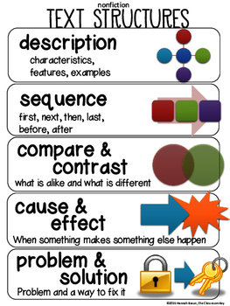
Paragraph patterns
Supporting sentences in a paragraph are often organized in ways specific to the purpose of the paragraph
Paragraph patterns refer to ways to organize content of a paragraph. Five common patterns:
Description
Sequence
Compare / contrast
Cause/ effect
Problem / solution

Slide 18
Transition words
A reader may recognize a paragraph pattern by identifying the transition words that link supporting sentences in a paragraph

Slide 19
Paragraph Pattern: Description
Uses detail and images to give the reader a mental image
A reader tries to visualize the parts and their relationship
Needs to describe the parts in a logical order
 | Signal words
Space | Above, beneath, under, over, straight ahead, surrounding, opposite, behind, nearby, beside, beyond, across, adjacent
Direction | Left, right, top, at the bottom, at the rear, at the front, side, edge, forefront, in the center
Features | Consist of, specifically, especially, in particular, in detail, namely, including

Slide 20
Coherence
Coherence refers to logic connection between sentences in a paragraph
In simple description pattern, all sentences are related to the same topic. Repeating the topic string is enough to achieve coherence
If several topics are introduced, each new topic should be related to a previous topic when introduced.

Slide 21
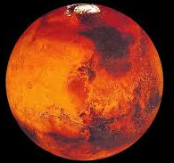
Mars is the fourth planet from the Sun in the Solar System and the second-smallest solid planet. Mars is a cold terrestrial planet with polar ice caps of frozen water and carbon dioxide. It has the largest volcano in the Solar System, and some very large impact craters. Mars is named after the mythological Roman god of war because it appears of red colour.
Topic | description
Mars | Location, size
Mars | Cold, ice caps
It | Largest volcano, craters
Mars | Name, reddish appearance
Notes:
https://simple.wikipedia.org/wiki/Mars

Slide 22
First sentence defines the topic ‘Python’. Second sentences share the same topic.
Introduce new topic ‘Guido’, relate it to previous topic ‘Python’
Python is an open source programming language. Python was made to be easy-to-read and powerful. A Dutch programmer named Guido van Rossum made Python in 1991. He named it after the television show Monty Python's Flying Circus. Many Python examples and tutorials include jokes from the show.
Use pronoun to refer to ‘Guido’, and introduce a new topic ‘Python show’
Use ‘the show’ to refer to the topic ‘Python show’, and relate it back to the topic ‘Python’
Python
Invented
Examples include jokes from
Guido
Use to name
Python show
Notes:
https://simple.wikipedia.org/wiki/Python_(programming_language)

Slide 23
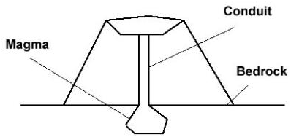
Spatial description
Volcanoes are a feared and destructive force for good reason. A volcano is like a pressure valve for the inner earth, but they can also be very beautiful. One part of the volcano that people rarely see is the magma chamber. The magma chamber is way beneath the Earth’s bed rock. It is tremendously hot. Running from the magma chamber to the crater of the volcano is the conduit. The conduit connects the magma chamber to the outer world. At the top of the volcano is the crater. This is where the magma exits. Volcanoes are a beautiful yet dangerous natural phenomenon.
Notes:
https://www.ereadingworksheets.com/text-structure/patterns-of-organization/spatial/

Slide 24
Data model description
Customer’s information, including email addr, password and address, are stored in the Customer table. The system assigns a unique customer ID to each customer at registration. This ID serves as the primary key of the Customer table.
Assigned at registration
Primary key: ‘customer ID’
Customer table
Customer
Attribute: ‘email addr’
Attribute: ‘password’
Attribute: ‘address’
customerID
emailAddr password address

Slide 25
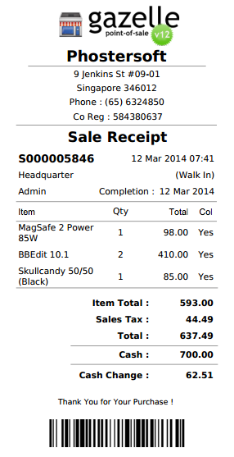
Data model description
Two tables are used to stored information in a sale transaction. First, a row is added to the table Invoice, with the system-generated invoice number as primary key. This row consists of sale datetime, location, cashier and total sale amount. The items in the transaction are recorded in another table, namely InvoiceItem. This table contains attributes itemName, qty, and cost. Invoice items are linked to the invoice through a foreign key.
Invoice
InvoiceItem
invoiceNum dateTime location cashier totalAmount
invoiceNum lineNum
itemName qty cost

Slide 26
Paragraph Pattern: Sequence
Authors explain how things happen in order
Process / How-to: e.g. driving directions, assembly instructions
Sequence of events, workflow process: e.g. morning routine, development of a product
Needs to describe the steps in chronological order
Readers can visualize the text as a sequence of steps
 | Transitions / signal words
Begin | First, initially, to begin with
Continue | Second, afterward, later, meanwhile, then, during
Finish | Lastly, eventually, finally, ultimtely

Slide 27
The process of database design includes three steps. First, in requirement analysis, you have to identify the data that the database will include, where the data comes from, and how it will be used. The next step is to lay out a visual representation of the database in conceptual design. Related data are grouped into entities. Afterwards, you are ready to analyze the relationships (1:1, 1:many, or many:many) between those tables. The outcome of conceptual design is often documented as an ER diagram. In the last step, you can apply normalization rules to make sure the tables are structured correctly.
Notes:
Summarize from
https://www.lucidchart.com/pages/database-diagram/database-design

Slide 28
We followed the steps in Figure 2 to do the predictions. Firstly, we used the crawler to get data about environment from the Sina micro-blog and Baidu TieBa. When we got enough data from users, we tried to eliminate the irrelevant data and use text model to express the content. Secondly, we input the training data into the SVM to get the most suitable hyper plane. Then, we predicated the emotional tendency toward the environment based on this hyper plane. Finally, we constructed the environment evaluation model and obtained the environment monitoring result for some major cities in China every month from January 2015 to June 2016 and environmental quality ranking for 27 provinces in China in 2015.
Notes:
From Wang et al. (2016) Monitoring Environmental Quality by Sniffing Social Media

Slide 29
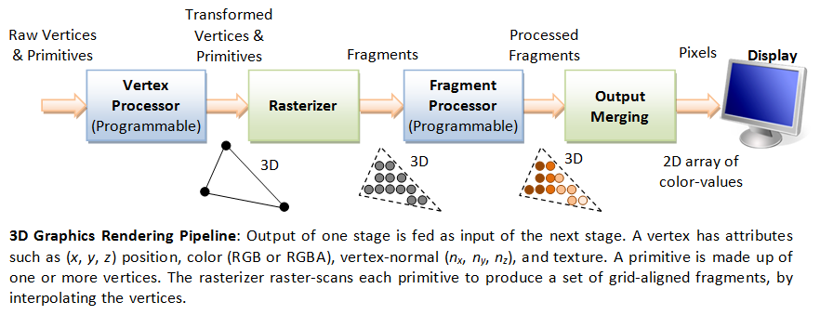
Pipelines
In computing, a pipeline refers to a series of processing stages in which the output from one stage is fed as input to the next stage.
https://www.ntu.edu.sg/home/ehchua/programming/opengl/CG_BasicsTheory.html

Slide 30
Paragraph Pattern: Compare & Contrast
Authors explain how two things are alike and/or how they are different
Determine point of comparison
Often a point-by-point approach is better to structure the text
Readers can visualize the comparison as a table or Venn diagram
 | Transitions / signal words
Compare | First, also, similarly, like, likewise, too, as well as, both, not only … but also …
Contrast | Unlike, on the other hand, instead, however, in spite of, on the contrary, as opposed to

Slide 31
ArrayList and LinkedList both implements List interface and their methods and results are almost identical. They both maintain the elements insertion order which means while displaying ArrayList and LinkedList elements the result set would be having the same order in which the elements got inserted into the List.
However there are few differences between them which make one better over another depending on the requirement.
1) Search: ArrayList search operation is pretty fast compared to the LinkedList search operation. get(int index) in ArrayList gives the performance of O(1) while LinkedList performance is O(n).
2) Deletion: LinkedList remove operation gives O(1) performance while ArrayList gives variable performance: O(n) in worst case (while removing first element) and O(1) in best case (While removing last element).
3) Inserts Performance: LinkedList add method gives O(1) performance while ArrayList gives O(n) in worst case.
4) Memory Overhead: ArrayList maintains indexes and element data while LinkedList maintains element data and two pointers for neighbor nodes hence the memory consumption is high in LinkedList comparatively.
Notes:
https://beginnersbook.com/2013/12/difference-between-arraylist-and-linkedlist-in-java/

Slide 32
Point of comparison | ArrayList | LinkedList
Interface | List (same) | List (same)
Search | Faster. O(1) | Slower. O(n)
Delete | Slower. O(n) | Faster. O(1)
Insert | Slower. O(n) | Faster. O(1)
Memory overhead | Lower | Higher
Conclusion
1) As explained above the insert and remove operations give good performance (O(1)) in LinkedList compared to ArrayList(O(n)). Hence if there is a requirement of frequent addition and deletion in application then LinkedList is a best choice.
2) Search (get method) operations are fast in Arraylist (O(1)) but not in LinkedList (O(n)) so If there are less add and remove operations and more search operations requirement, ArrayList would be your best bet.

Slide 33
Paragraph Pattern: Cause & Effect
Cause
Effect
Authors explain reasons why something happened or the effects of something
Give reasons why something happened
Give results of an action
Cause
Effect
 | Transitions / signal words
Cause | Because, because of, since, one cause is, one reason is
Effect | Consequently, as a result, therefore, thus, accordingly

Slide 34
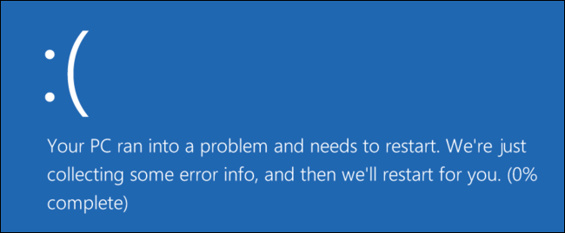
Blue screens are generally caused by problems with your computer’s hardware or issues with its hardware driver software. Sometimes, they can be caused by issues with low-level software running in the Windows kernel. Regular apps usually won’t be able to cause blue screens. If an app crashes, it will do so without taking the operating system out with it.
A blue screen occurs when Windows encounters a “STOP Error.” This critical failure causes Windows to crash and stop working. The only thing Windows can do at that point is restart the PC. This can lead to data loss, as programs don’t have a chance to save their open data.
Hardware problem
Driver issue
Data loss
Kernel software
Regular app
Notes:
https://www.howtogeek.com/163452/everything-you-need-to-know-about-the-blue-screen-of-death/

Slide 35




The night’s snowstorm had many effects. People were out shoveling snow from their sidewalks. The power lines were draped with ice. Snow plows drove down every street. Children were the happiest of all. The unexpected snow caused school to be cancelled!
snowstorm
Notes:
https://www.youtube.com/watch?v=gOnNMwFdX0Y

Slide 36
Exercise
Find the causes and effects in the paragraph below?
Find the causes and effects in the first two paragraphs in https://www.any-data-recovery.com/fix-windows-system-errors/how-to-fix-error-windows-detected-a-hard-disk-problem.html
Traditionally, mobile operating systems require gigabits of memory and storage to operate; this is one reason your cellphone costs so much money. In comparison, IoT devices have small footprints and are heavily constrained by their hardware. As a result, they cannot operate with traditional mobile operating systems without becoming expensive pieces of hardware.
Notes:
https://www.engineering.com/ElectronicsDesign/ElectronicsDesignArticles/ArticleID/11511/IoT-Operating-System-Runs-Multiple-Low-Memory-Devices-Over-a-Common-User-Interface.aspx

Slide 37
Paragraph Pattern: Problem & Solution
Authors point out a problem and propose a solution
Problem – dilemma, concerning issue, usually with negative effect
Solution – remedy
 | Transitions / signal words
problem | issue, problem, concern, difficulty, uncertainty
solution | propose, solution, answer, remedy, prevention, fix

Slide 38
Most websites don’t allow you to sign in with more than one account at a time. But private browsing mode offers a solution. Rather than signing out and signing in with another account, you can stay signed in in your main browsing window and open a private browsing window alongside it. Sign into a different account in the private browsing window and you’ll be signed into two accounts at once.
Notes:
https://www.howtogeek.com/251230/five-worthwhile-uses-for-private-browsing-mode-besides-porn/

Slide 39
Example
Find the problem and solution in the following pages
http://malwarecomplaints.info/firefox-57-will-add-full-tracking-protection/
https://economictimes.indiatimes.com/magazines/panache/struggling-with-poor-wifi-signal-here-are-simple-ways-to-improve-coverage/articleshow/58822296.cms
https://business.tutsplus.com/articles/how-to-stop-junk-email--cms-29427

Slide 40
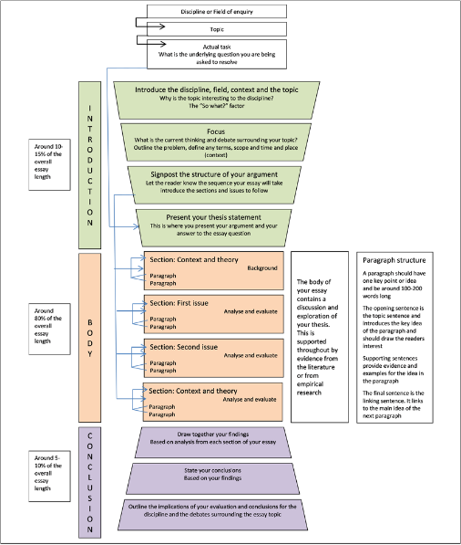
Notes:
https://www.usq.edu.au/learningcentre/assignment-skills/writing-assignments/essay-structure

